Slide 1
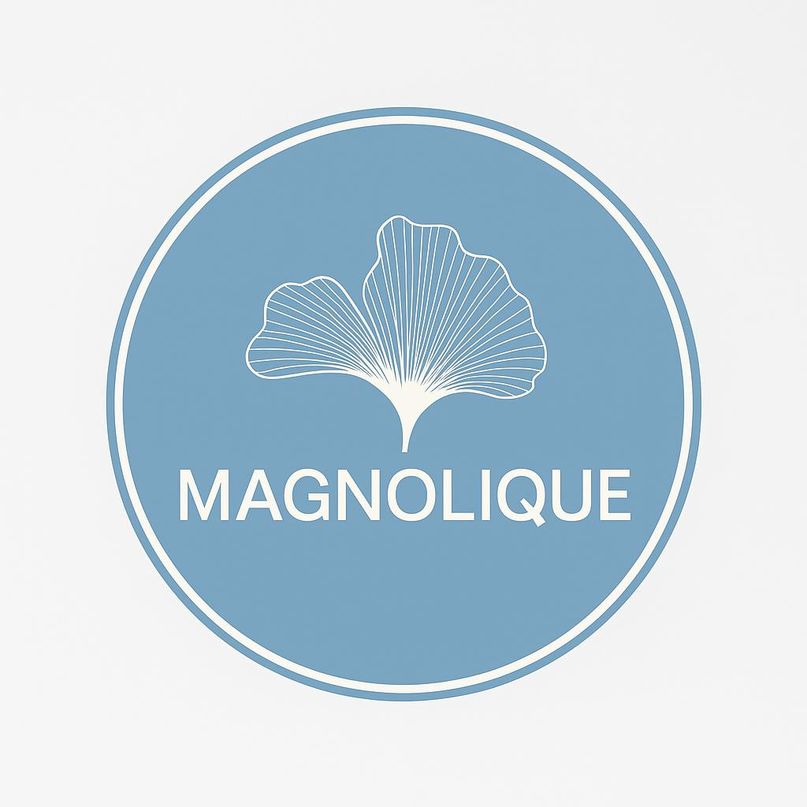
MAGNOLIQUE where the Science Meets Nature
Premium Dermo-Cosmetics | Swiss Formulations | Made in The Netherlands
Stocklot Opportunity 2026

Slide 2
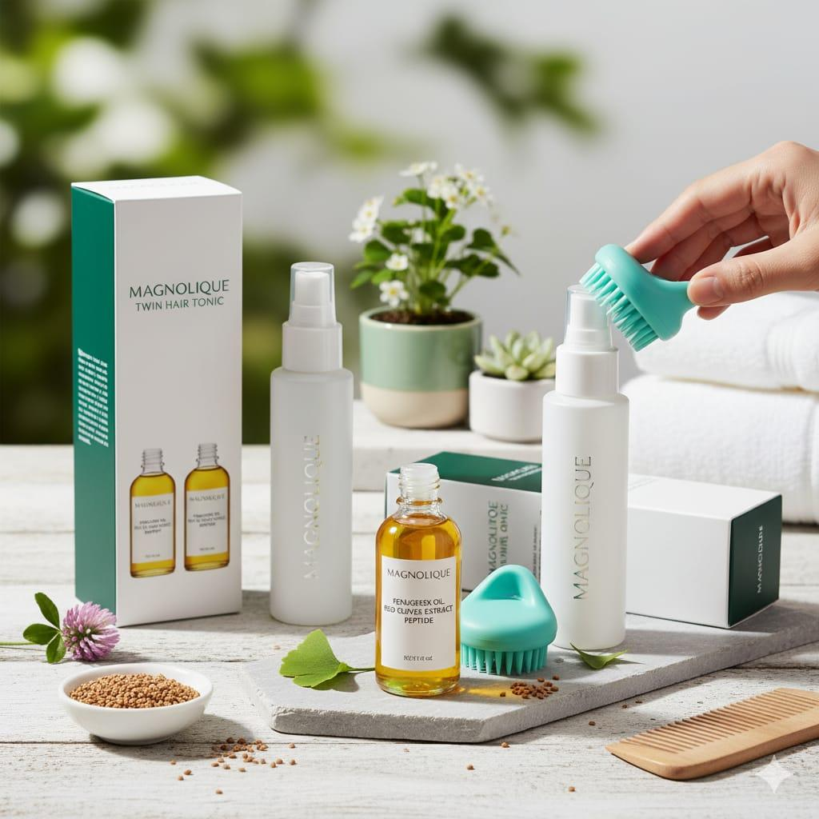
Brand Overview
Founded by a Dermatologist dedicated to skin health
Magnolique bridges the gap between clinical efficacy and
natural care.
Swiss-Inspired Formulations: Developed in collaboration with
top Swiss laboratories (Mind the Beauty).
Clean Beauty: Cruelty-free, Eco-friendly, and free from harsh
chemicals like Hydroquinone.
Premium Positioning: High-end packaging designed for the
European market.

Slide 3
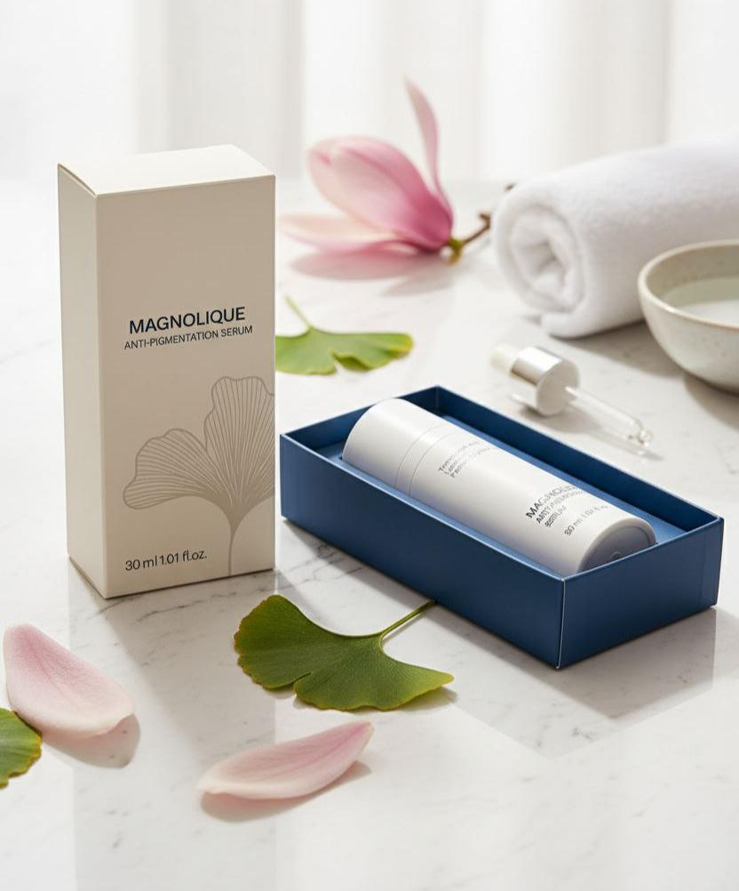
Product 01 – Anti‑Pigmentation Serum
A powerful, non-hydroquinone brightening serum designed to reduce dark spots and even skin tone.
Key Actives: Tranexamic Acid, Sodium Ascorbyl
Phosphate (SAP), Lactobacillus Ferment Lysate.
Claims: Reduces pigmentation, hydrates, and
brightens without irritation. Safe for long-term daily
use
Format: 30ml Airless Pump Bottle
Made in: The Netherlands
Shelf Life: 24 Months
Master Carton: 21 Units
RRP (Retail Price): €35

Slide 4
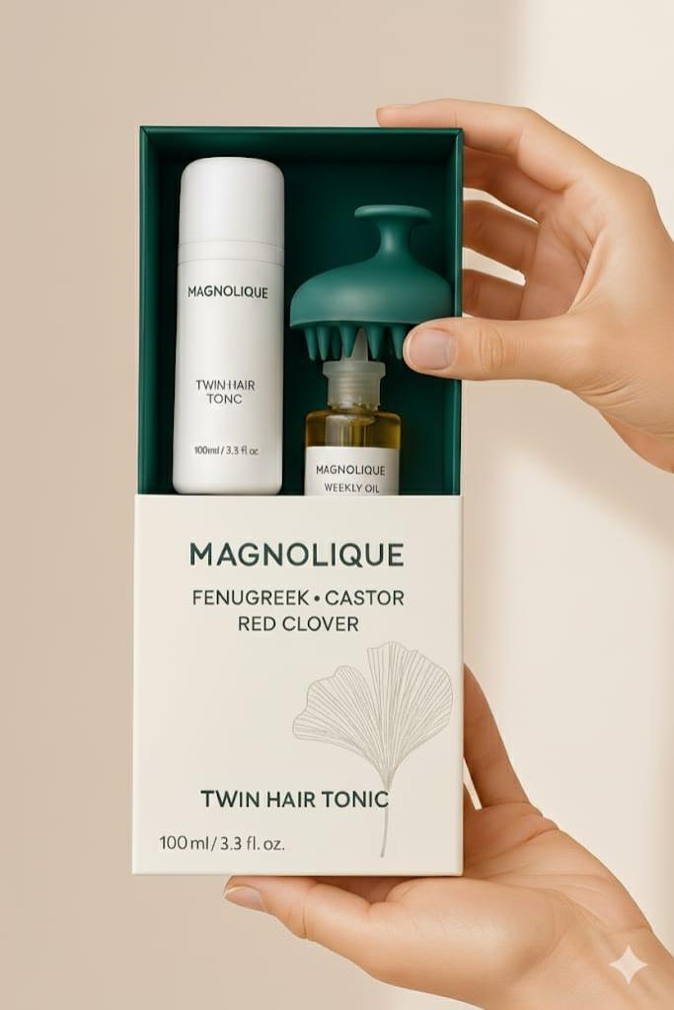
Product 02 – Twin Hair Tonic System
A comprehensive dual-action system for scalp vitality and hair shedding reduction.
The Kit Includes:
Daily Tonic : With Red Clover extract to energize the scalp.
Weekly Oil : With Fenugreek & Castor Oil for deep nourishment.
Scalp Massager: Professional silicone tool for
mechanical stimulation.
Innovation: Combines mechanical massage with chemical
actives for maximum absorption.
Packaging: Premium Gift Box (German Design)
Master Carton: 21 Sets
Retail price : 72.50 Euro

Slide 5
Offer Summary
STOCKLOT LIQUIDATION OFFER :
We are looking for a strategic partner to acquire the current stock in the Netherlands.
Location: Warehoused in The Netherlands (EU Duty Paid).
Condition: Brand New, Factory Sealed.
Total Available Quantity: ~6,000 Units.
Marketing Assets: High-resolution images and social media content are included with the purchase.
Contact us :
Sepanta Minoo B.V.
Email : Commercial @magnolique.nl
WhatsApp: +31613654763

